Slide 1
Concurrency Control

Slide 2
Serializability
Basic Assumption – Each transaction preserves database consistency.
Serial execution of a set of transactions preserves database consistency.
A (possibly concurrent) schedule is serializable if it is equivalent to a serial schedule.
Different forms of schedule equivalence give rise to the notions of:
  1. conflict serializability
  2. view serializability

Slide 3
Conflicting Instructions
Instructions l_{i} and l_{j} of transactions T_{i} and T_{j} respectively, conflict if and only if there exists some item Q accessed by both l_{i} and l_{j}, and at least one of these instructions wrote Q.
1. l_{i} = read(Q), l_{j} = read(Q). l_{i} and l_{j} don’t conflict.
2. l_{i} = read(Q), l_{j} = write(Q). They conflict.
3. l_{i} = write(Q), l_{j} = read(Q). They conflict
4. l_{i} = write(Q), l_{j} = write(Q). They conflict
Intuitively, a conflict between l_{i} and l_{j} forces a (logical) temporal order between them.
  If l_{i} and l_{j} are consecutive in a schedule and they do not conflict, their results would remain the same even if they had been interchanged in the schedule.

Slide 4
Conflict Serializability
If a schedule S can be transformed into a schedule S´ by a series of swaps of non-conflicting instructions, we say that S and S´ are conflict equivalent.
We say that a schedule S is conflict serializable if it is conflict equivalent to a serial schedule

Slide 5


Conflict Serializability (continued)
Schedule 3 can be transformed into Schedule 6, a serial schedule where T₂ follows T₁, by series of swaps of non-conflicting instructions. Therefore Schedule 3 is conflict serializable.
Schedule 3
Schedule 6

Slide 6

Conflict Serializability (continued)
Example of a schedule that is not conflict serializable:
We are unable to swap instructions in the above schedule to obtain either the serial schedule < T₃, T₄ >, or the serial schedule < T₄, T₃ >.

Slide 7

Other Notions of Serializability
The schedule below produces same outcome as the serial schedule < T₁, T₅ >, yet is not conflict equivalent.
Determining such equivalence requires analysis of operations other than read and write.

Slide 8

Testing for Serializability
Consider some schedule of a set of transactions T₁, T₂, ..., T_{n}
Precedence graph — a directed graph where the vertices are the transactions (names).
We draw an arc from T_{i} to T_{j} if the two transaction conflict, and T_{i} accessed the data item on which the conflict arose earlier.
We may label the arc by the item that was accessed.
Example 1

Slide 9

Test for Conflict Serializability
A schedule is conflict serializable if and only if its precedence graph is acyclic.
Cycle-detection algorithms exist which take order n² time, where n is the number of vertices in the graph.
  Better algorithms take order n + e where e is the number of edges.
If precedence graph is acyclic, the serializability order can be obtained by a topological sorting of the graph.
  This is a linear order consistent with the partial order of the graph.

Slide 10

Recoverable Schedules
Need to address the effect of transaction failures on concurrently
running transactions.
Recoverable schedule — if a transaction T_{j} reads a data item previously written by a transaction T_{i} , then the commit operation of T_{i} appears before the commit operation of T_{j}.
The following schedule is not recoverable if T₉ commits immediately after the read
If T₈ should abort, T₉ would have read (and possibly shown to the user) an inconsistent database state.
Database must ensure that schedules are recoverable.

Slide 11

Cascading Rollbacks
Cascading rollback – a single transaction failure leads to a series of transaction rollbacks. Consider the following schedule where none of the transactions has yet committed (so the schedule is recoverable)
If T₁₀ fails, T₁₁ and T₁₂ must also be rolled back.
Can lead to the undoing of a significant amount of work

Slide 12
Cascadeless Schedules
Cascadeless schedules — cascading rollbacks cannot occur if for each pair of transactions T_{i} and T_{j} such that T_{j} reads a data item previously written by T_{i}, the commit operation of T_{i} appears before the read operation of T_{j}.
Every cascadeless schedule is also recoverable
It is desirable to restrict the schedules to those that are cascadeless

Slide 13
Concurrency Control
A database must provide a mechanism that will ensure that all possible schedules are
  conflict serializable, and
  are recoverable and preferably cascadeless
A policy in which only one transaction can execute at a time generates serial schedules, but provides a poor degree of concurrency
  Are serial schedules recoverable/cascadeless?
Testing a schedule for serializability after it has executed is a little too late!
Goal – to develop concurrency control protocols that will assure serializability.

Slide 14
Concurrency Control (continued)
Schedules must be conflict serializable, and recoverable, for the sake of database consistency, and preferably cascadeless.
A policy in which only one transaction can execute at a time generates serial schedules, but provides a poor degree of concurrency.
Concurrency-control schemes tradeoff between:
  the amount of concurrency they allow, and
  the amount of overhead that they incur.

Slide 15
Locking-based Concurrency Control
Lock:
  Guarantee exclusive use of a data item to a current transaction
  T2 does not have access to a data item that is currently being locked by T1
T1 acquires a lock on an item prior to data access
The lock is released after the transaction is completed:
  Other transactions can lock the item

Slide 16
Locking Algorithms
Lock manager:
  A module that is responsible for assigning the locks to transactions
Lock types:
  Binary locks:
    An item can be in one of two states:
      LOCKED
      UNLOCKED
  Shared/Exclusive locks:
    An item can be in one of three states:
      UNLOCKED
      SHARED lock by more than one transaction
      EXCLUSIVE lock by only one transaction

Slide 17
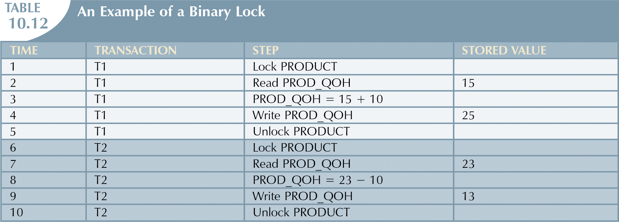
Solves the Lost update problem

Slide 18
Lock-Based Protocols (continued)
Example of a transaction performing locking:
T₂: lock-S(A);
read (A);
unlock(A);
lock-S(B);
read (B);
unlock(B);
display(A+B)
Locking as above is not sufficient to guarantee serializability — if A and B get updated in-between the read of A and B, the displayed sum would be wrong.
A locking protocol is a set of rules followed by all transactions while requesting and releasing locks. Locking protocols restrict the set of possible schedules.

Slide 19
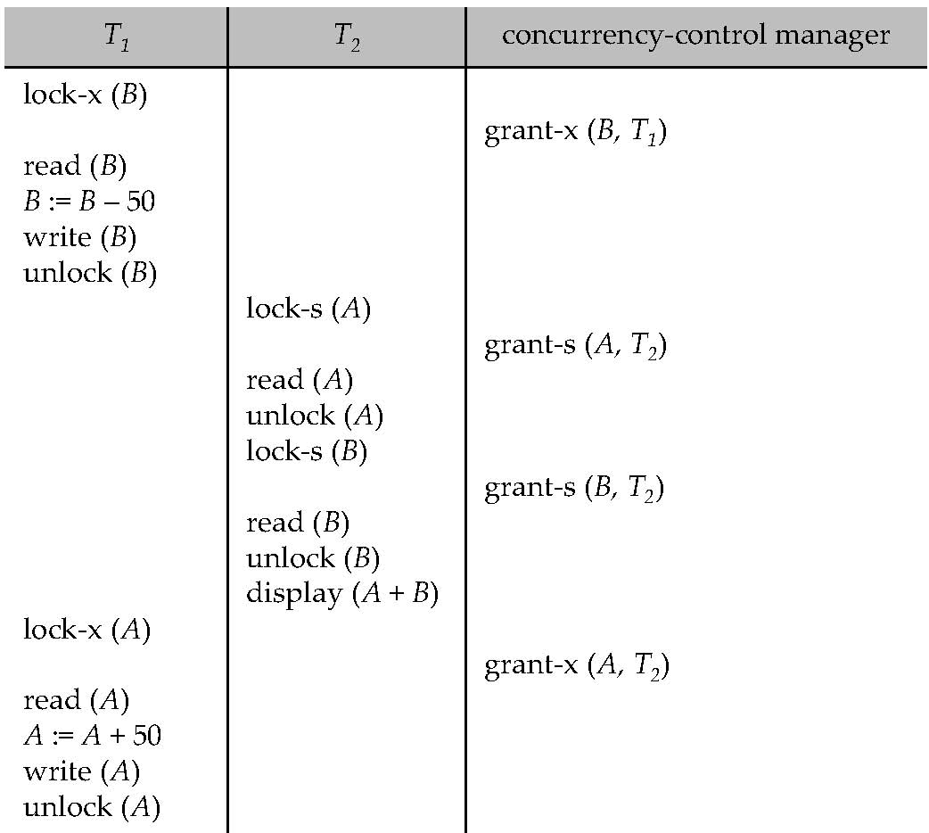
Example

Slide 20
Binary Locks (continued)
Binary lock is too restrictive
  T1 does not need to lock an object if it only reads
Two operations conflict only if one of them is WRITE

Slide 21
Shared/Exclusive Locks
A lock can be in three states:
  Unlocked, shared, or exclusive
Exclusive mode (X):
  Access is reserved only for the transaction that locked the object
  When there is a potential conflict
  Granted if:
    Operation is WRITE
    The object does not hold any other locks
Shared mode (S):
  When concurrent transactions only reads the object
  Granted if:
    Operation is READ
    The object does not hold any exclusive locks

Slide 22
Mutual Exclusive Rule
Only one transaction at a time can own an exclusive lock on the same object

Slide 23

Lock-Based Protocols (continued)
Lock-compatibility matrix
A transaction may be granted a lock on an item if the requested lock is compatible with locks already held on the item by other transactions
Any number of transactions can hold shared locks on an item,
  but if any transaction holds an exclusive on the item no other transaction may hold any lock on the item.
If a lock cannot be granted, the requesting transaction is made to wait till all incompatible locks held by other transactions have been released. The lock is then granted.

Slide 24

Pitfalls of Lock-Based Protocols: Deadlock
Consider the partial schedule
Neither T₃ nor T₄ can make progress — executing lock-S(B) causes T₄ to wait for T₃ to release its lock on B, while executing lock-X(A) causes T₃ to wait for T₄ to release its lock on A.
Such a situation is called a deadlock.
  To handle a deadlock one of T₃ or T₄ must be rolled back
  and its locks released.

Slide 25
Pitfalls of Lock-Based Protocols: Starvation
Starvation is also possible if concurrency control manager is badly designed. For example:
  A transaction may be waiting for an X-lock on an item, while a sequence of other transactions request and are granted an S-lock on the same item.
  The same transaction is repeatedly rolled back due to deadlocks.
Concurrency control manager can be designed to prevent starvation as follows:
  A lock is provided for an item Q if
    there is no other transactions that are waiting for a lock on Q

Slide 26
Two-phase locking
An algorithm to define how transactions can acquire and release locks
Guarantee serializability
Two phases:
    A growing phase
    A shrinking phase

Slide 27
Two-phase locking (continued)
Growing phase:
  A transaction acquires all required lock without unlocking any data
  The transaction is in its locked point:
    When all locks have been acquired
Shrinking phase:
  A transaction releases all locks
  Cannot obtain any new locks

Slide 28
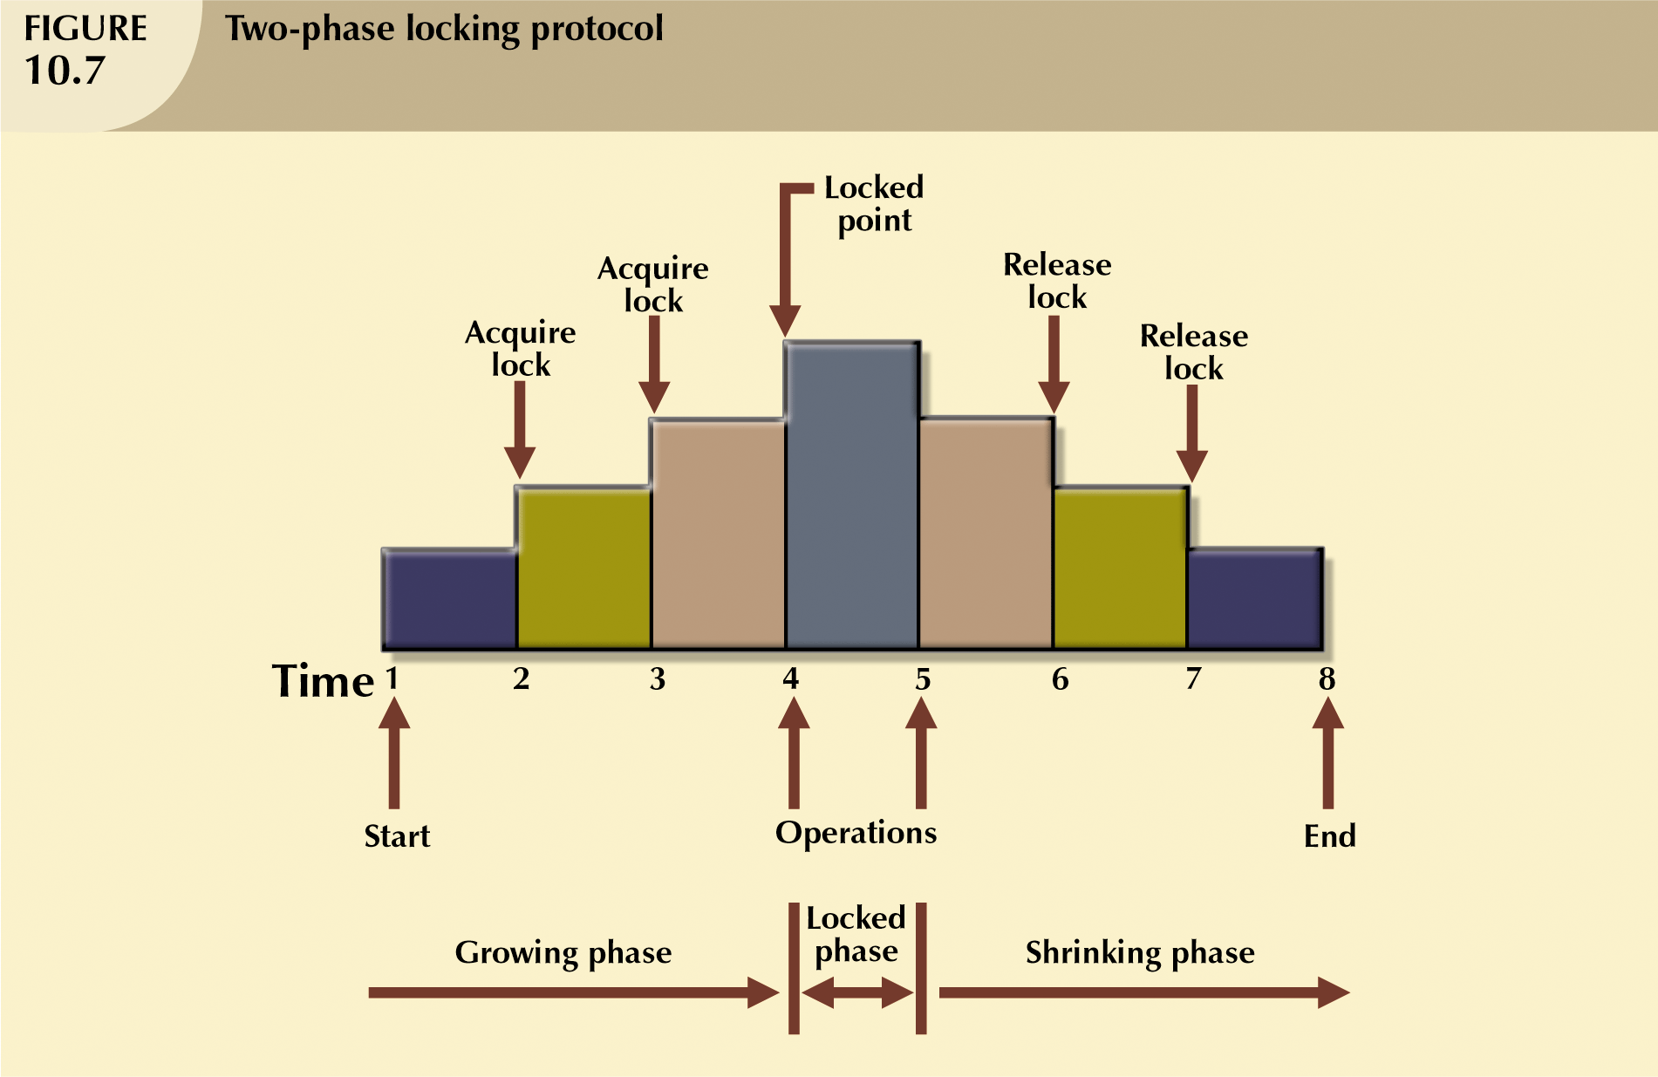

Slide 29
This schedule does not follow 2PL
T2 unlocked A early so that T1 can see inconsistent data

Slide 30
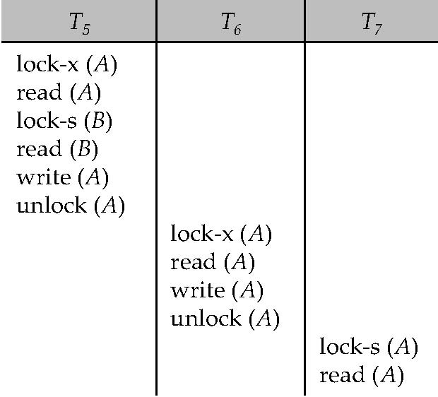
Can 2PL cause cascading roll back?

Slide 31
The Two-Phase Locking Protocol (continued)
Two-phase locking does not ensure freedom from deadlocks
Cascading roll-back is possible under two-phase locking. To avoid this, follow a modified protocol called strict two-phase locking. Here a transaction must hold all its exclusive locks till it commits/aborts.

Slide 32
Deadlocks
When two transactions wait indefinitely for each other to unlock data
Example:
  T1 ➔ accesses X and Y
  T2 ➔ accesses Y and X
    T1 locked X
    T2 locked Y
    T1 is waiting to lock Y in order to finish
    T2 is waiting to lock X in order to finish
  T1 and T2 each is waiting to the other one to unlock an item

Slide 33
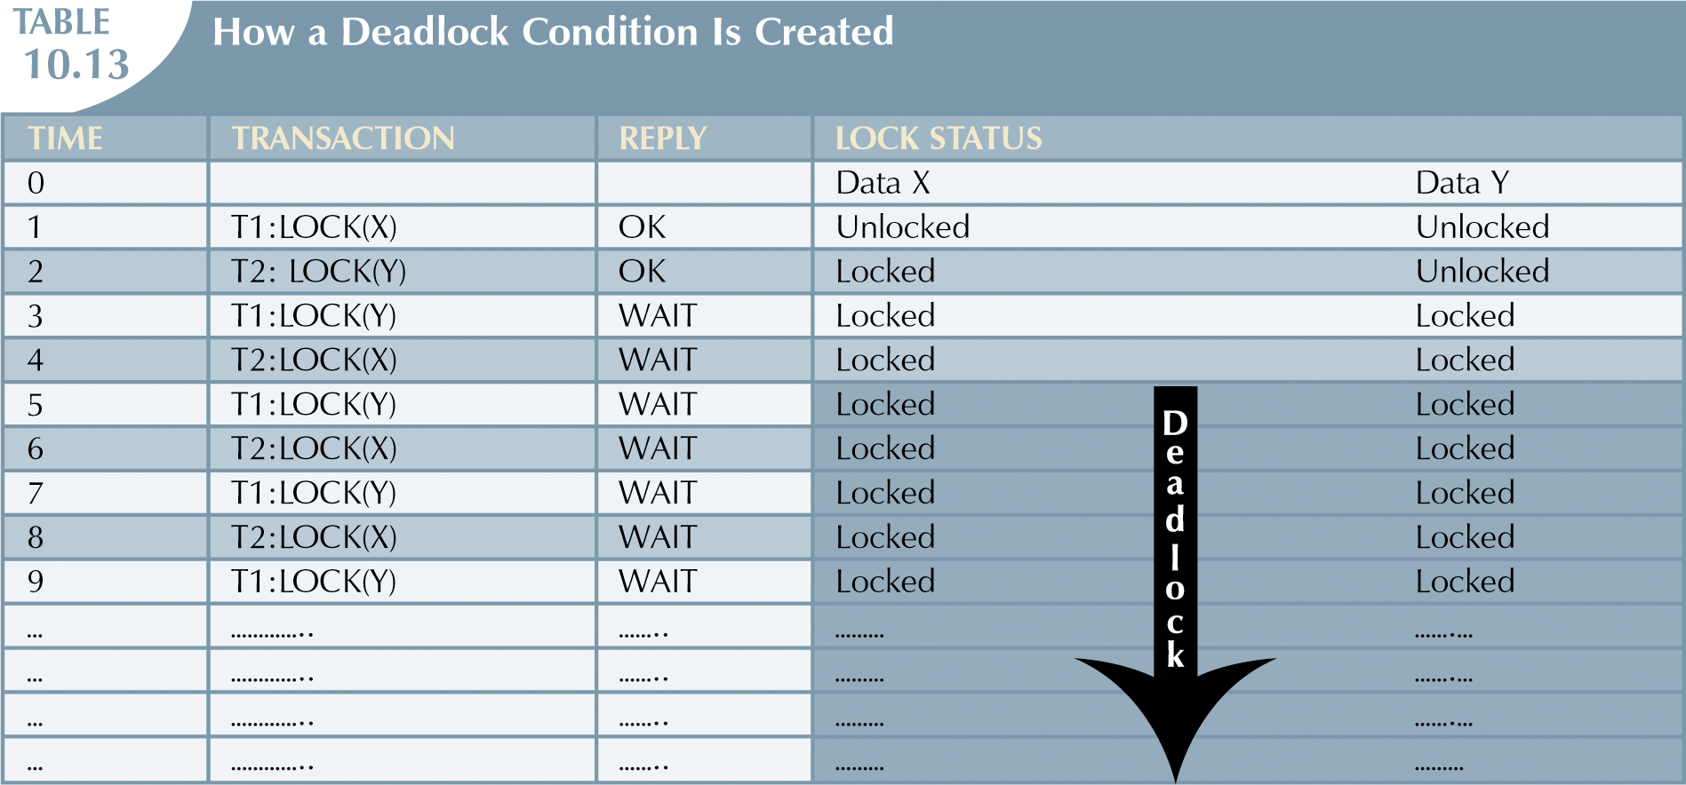

Slide 34

Deadlock Handling
Consider the following two transactions:
T₁: write (X) T₂: write(Y)
write(Y) write(X)
Schedule with deadlock

Slide 35
Deadlock Handling
System is deadlocked if there is a set of transactions such that every transaction in the set is waiting for another transaction in the set.
Deadlock prevention protocols ensure that the system will never enter into a deadlock state.
Deadlock detection and recovery

Slide 36
Deadlock Prevention
Protocol 1: Require that each transaction locks all its data items before it begins execution (predeclaration).
Protocol 2: use transaction timestamps for the sake of deadlock prevention alone.
  wait-die scheme — non-preemptive
    older transaction may wait for younger one to release data item. Younger transactions never wait for older ones; they are rolled back instead.
  wound-wait scheme — preemptive
    older transaction wounds (forces rollback) of younger transaction instead of waiting for it. Younger transactions may wait for older ones.
  Both in wait-die and in wound-wait schemes, a rolled back transactions is restarted with its original timestamp.

Slide 37
Deadlock prevention (continued)
Protocol 3: Timeout-Based Schemes:
  a transaction waits for a lock only for a specified amount of time. After that, the wait times out and the transaction is rolled back.
  thus deadlocks are not possible
  simple to implement; but starvation is possible. Also difficult to determine good value of the timeout interval.

Slide 38
Deadlock Detection
Deadlocks can be described as a wait-for graph, which consists of a pair G = (V,E),
  V is a set of vertices (all the transactions in the system)
  E is a set of edges; each element is an ordered pair T_{i} →T_{j}.
If T_{i} → T_{j} is in E, then there is a directed edge from T_{i} to T_{j}, implying that T_{i} is waiting for T_{j} to release a data item.
When T_{i} requests a data item currently being held by T_{j}, then the edge T_{i} T_{j} is inserted in the wait-for graph. This edge is removed only when T_{j} is no longer holding a data item needed by T_{i}.
The system is in a deadlock state if and only if the wait-for graph has a cycle. Must invoke a deadlock-detection algorithm periodically to look for cycles.

Slide 39


Deadlock Detection (continued)
Wait-for graph without a cycle
Wait-for graph with a cycle

Slide 40
Deadlock Recovery
When deadlock is detected :
  Some transaction will have to rolled back (made a victim) to break deadlock. Select that transaction as victim that will incur minimum cost.
  Rollback -- determine how far to roll back transaction
    Total rollback: Abort the transaction and then restart it.
    More effective to roll back transaction only as far as necessary to break deadlock.
  Starvation happens if same transaction is always chosen as victim. Include the number of rollbacks in the cost factor to avoid starvation

Slide 41
When to use the different deadlock handling techniques?
Possibility of deadlock:
  Low ➔ Deadlock detection & recovery
  High ➔ Deadlock prevention

